Slide 1
Software Quality

Slide 2
Quality software refers to a software which is reasonably bug or defect free, is delivered in time and within the specified budget, meets the requirements and/or expectations, and is maintainable
Software quality product is defined in term of its fitness of purpose. That is, a quality product does precisely what the users want it to do.

Slide 3
This approach to software quality is best exemplified by fixed quality models, such as ISO/IEC 25010:2011. This standard describes a hierarchy of eight quality characteristics, each composed of sub-characteristics
Functional suitability
Reliability
Operability
Performance efficiency
Security
Compatibility
Maintainability
Transferability

Slide 4
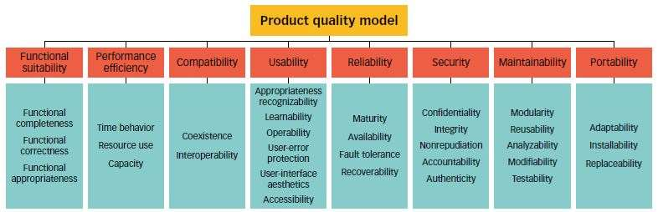

Slide 5
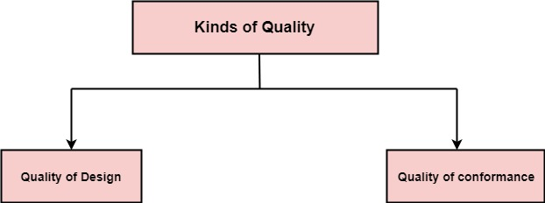

Slide 6
Software Quality Assurance (SQA) is simply a way to assure quality in the software. It is the set of activities which ensure processes, procedures as well as standards are suitable for the project and implemented correctly.
Software Quality Assurance is a process which works parallel to development of software. It focuses on improving the process of development of software so that problems can be prevented before they become a major issue. Software Quality Assurance is a kind of Umbrella activity that is applied throughout the software process.

Slide 7
Major Software Quality Assurance Activities
SQA Management Plan
Make a plan for how you will carry out the sqa through out the project. Think about which set of software engineering activities are the best for project. check level of sqa team skills.
Set The Check Points
SQA team should set checkpoints. Evaluate the performance of the project on the basis of collected data on different check points.

Slide 8
Multi testing Strategy
Do not depend on a single testing approach. When you have a lot of testing approaches available use them
Measure Change Impact
The changes for making the correction of an error sometimes re introduces more errors keep the measure of impact of change on project. Reset the new change to change check the compatibility of this fix with whole project.

Slide 9
Manage Good Relations
In the working environment managing good relations with other teams involved in the project development is mandatory. Bad relation of sqa team with programmers team will impact directly and badly on project. Don’t play politics.

Slide 10
Advantage of SQA
SQA produces high quality software.
High quality application saves time and cost.
SQA is beneficial for better reliability.
SQA is beneficial in the condition of no maintenance for a long time.
High quality commercial software increase market share of company.
Improving the process of creating software.

Slide 11
Disadvantage of SQA
There are a number of disadvantages of quality assurance. Some of them include
adding more resources,
employing more workers to help maintain quality and so much more.

